Slide 1
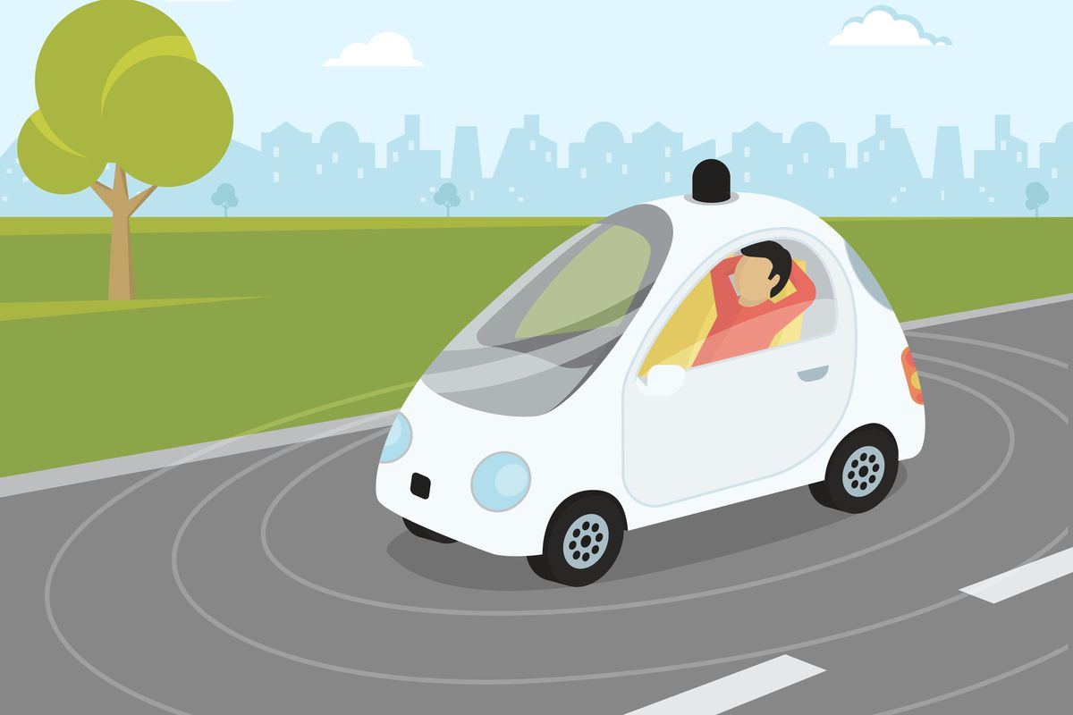
A Driving Decision Strategy(DDS) Based on Machine learning for an autonomous vehicle

Slide 2

Bvc Engineering College
Driving Decision Strategy(DDS) based on ML for Autonomous Vehicle
Presented By
Guided By
Sishir Bohara (18-5B9)
Rupali Adhikari(18-5C0)
Devram Yadav (18-5B8)
Pawan Lamichhane(18-5B6)
Dr. Gunamni Jana
(HOD and Professor)
Submitted for the partial fulfillment of
B-Tech
Computer Science and Engineering

Slide 3
Abstract
In this project we are describing concept for driving decision strategy by observing vehicle internal data such as steering and RPM(revolutions per minute) level to predict various classes such as speed (steering), changing lane etc.
All existing technique were concentrate on external data such as road condition and pedestrians etc but not concentrate on internal values. So to take efficient determination of steering condition and changing lane we are analysing internal data.
All internal data will be collected from sensor and then stored on cloud and then application will read data from cloud and apply machine learning algorithms to determine or predict steering condition or changing lane.

Slide 4
Key Terms
ANN : Artificial Neural Network
Genetic Algorithm : An adaptive heuristic search algorithm inspired by "Darwin's theory of evolution in Nature."
Sensor : A small device used to ad the data from an external and copy it to any kind of database.
Multilayer Perceptron : An algorithm for supervised learning of binary classifiers

Slide 5
Table Of Contents
Introduction
Three steps
Existing System
Disadvantages
Proposed System
Advantages
Requirements
Modules
Modules , Packages and Algorithms
How it works???
Design
Result
Conclusion
Reference

Slide 6
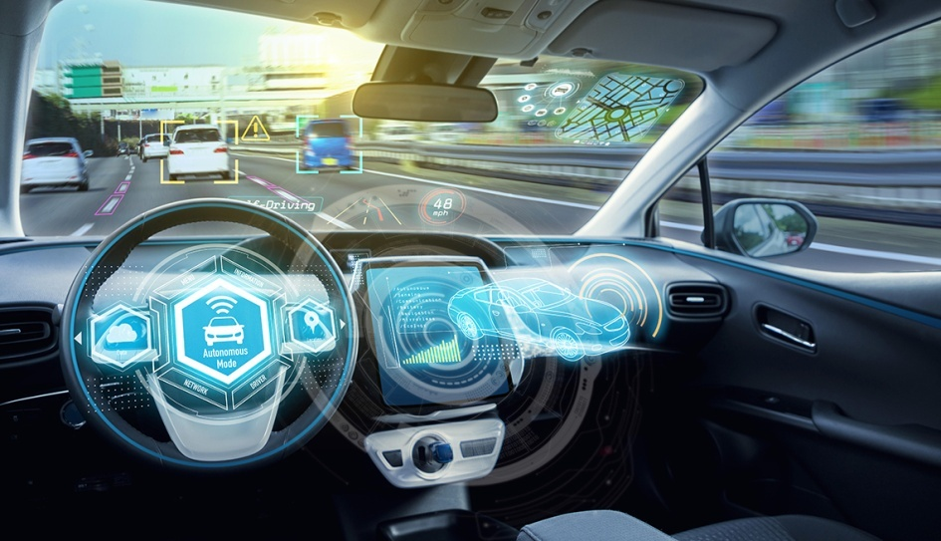
Introduction
Currently, global companies are developing technologies for advanced self-driving cars, which is in the 4th stage. Self-driving cars are being developed based on various ICT technologies, and the principle of operation can be classified into three levels of 1.Recognition
2.Judgement
3.Control

Slide 7
Three Steps
The recognition step is to recognize and collect information about surrounding situations by utilizing various sensors in vehicles such as GPS, camera and radar.
The judgement step determines the driving strategy based on the recognized information. Then, this step identifies and analyzes the conditions in which the vehicle is placed, and determines the driving plans appropriate to the driving environment and the objectives.
The control step determines the speed, direction, etc. about the driving and the vehicle starts driving on its own. An autonomous driving vehicle performs various actions to arrive at its destination, repeating the steps of recognition, judgement and control on its own.

Slide 8
Genetic algorithm
A genetic algorithm is an adaptive heuristic search algorithm inspired by "Darwin's theory of evolution in Nature."
It is used to solve optimization problems in machine learning. It is one of the important algorithms as it helps solve complex problems that would take a long time to solve.
Genetic Algorithms are being widely used in different real-world applications, for example, Designing electronic circuits, code-breaking, image processing, and artificial creativity.

Slide 9
Existing System
Self-driving cars use in-vehicle computers to compute data collected by sensors. As the amount of the computed data increases, it can affect the speed of judgment and control because of overload. These problems can threaten the stability of the vehicle.
To prevent the overload, some studies have developed hardware that can perform deep running operations inside the vehicle, while others use the cloud to compute the vehicle's sensor data.

Slide 10
Disadvantage
Its not generating perfect result.
There is no machine learning algorithms.

Slide 11
Proposed System
To implement this project we have introduced the algorithm called DDS (Driving Decision Strategy) algorithm which is based on Genetic Algorithm to choose optimal gene values which helps in taking better decision or prediction.
DDS algorithm obtained input from sensor and then pass to genetic algorithm to choose optimal value which helps in faster and efficient prediction.

Slide 12
Advantages
Propose DDS with genetic algorithm performance is comparing with existing machine learning algorithm such as Random Forest and MLP (multilayer perceptron algorithm.).
Propose DDS shows better prediction accuracy compare to random forest and MLP.

Slide 13
Requirements
Hardware Requirements:
System : Pentium i3/i5
Hard Disk : 500 GB
Input Devices : Keyboard, Mouse
RAM: 4 GB
Software Requirements:
Operating system : Windows10
Coding Language : Python 3.7.0

Slide 14
Can Be Ran On
Pycharm
Visual Studio Code
Command Prompt

Slide 15
Modules
Upload historical trajectory Dataset: using this module we will upload dataset to application and then find out total number records.
Generate train & test model: This module is read dataset and to split dataset into train and test part to generate machine learning train model
Run Random Forest: Using this module we will split dataset into train and test and then build Random Forest trained model. Trained model will be applied on test data to calculate and test prediction accuracy
Run MLP Algorithm: Using this module we will split dataset into train and test and then build MLP trained model. Trained model will be applied on test data to calculate and test prediction accuracy

Slide 16
Run DDS with genetic Algorithm: Using this module we will split dataset into train and test and then build genetic trained model. Trained model will be applied on test data to calculate and test prediction accuracy
Comparison Graph: Using this module we can conclude that DDS is performing well compare to other two algorithms.
Predict DDS type: using this module first record we can see decision is Lane Change and for second record values we got decision as ‘steering angle’ and for third test record we got predicted value as vehicle is in speed mode.

Slide 17
Packages
tkinter: tkinter is the standard GUI library for Python. tkinter module helps in creating GUI applications in a fast and easy way.
Matplotlib: Matplotlib is an amazing visualization library in Python for 2D plots of arrays. Matplotlib consists of several plots like line, bar, scatter etc.
Numpy: NumPy is a Python library used for working with arrays. It also has functions for working in domain of linear algebra, fourier transform, and matrices.

Slide 18
Pandas: Pandas is an open-source library that is made mainly for working with relational or labeled data both easily and intuitively it is used for Fast and efficient for manipulating and analyzing data.
Keras: Keras is a deep learning API written in Python, running on top of the machine learning platform Tensor Flow. It was developed with a focus on enabling fast experimentation.

Slide 19
Algorithms
Random Forest Algorithm:
This model has three random concepts, randomly choosing training data when making trees, selecting some subsets of features when splitting nodes and considering only a subset of all features for splitting each node in each simple decision tree. During training data in a random forest, each tree learns from a random sample of the data points.

Slide 20
Multi Layer Perceptron:
An MLP consists of at least three layers of nodes: an input layer, a hidden layer and an output layer. Except for the input nodes, each node is a neuron that is interfaced with a nonlinear activation function. MLP utilizes a supervised learning technique called backpropagation for training.

Slide 21
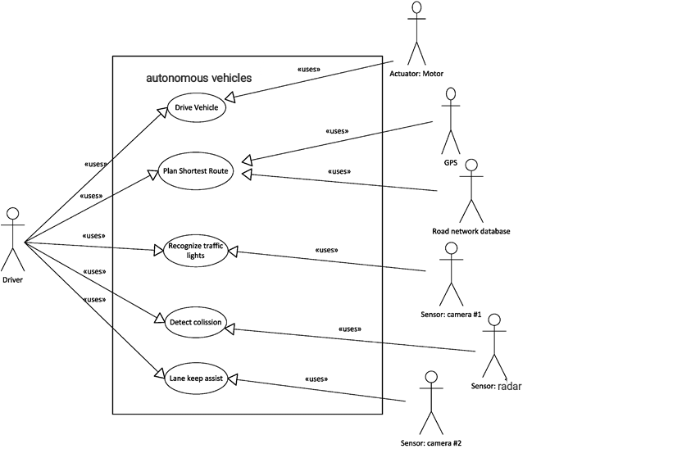
Design
Usecase Diagram:
Fig (a) : Usecase Diagram

Slide 22
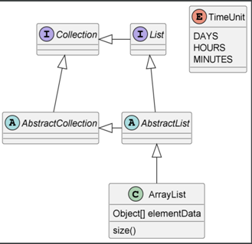
Class Diagram:
Fig (b) : Class Diagram

Slide 23
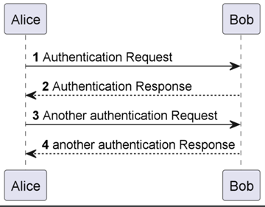
Sequence Diagram:
Fig(c) : Sequence Diagram

Slide 24
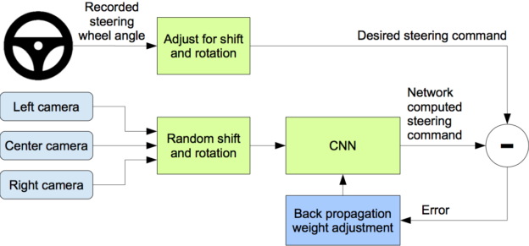
How It Works?
Fig(a) : Working of MLP, Cameras and the steering wheel

Slide 25
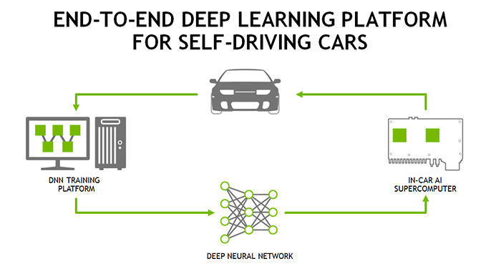
Fig (b) : Deep Learning Platform and working

Slide 26
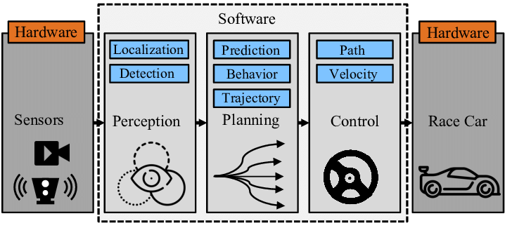
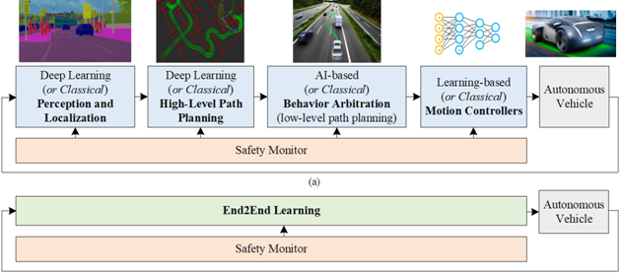
Fig ( c & d ) : Internal Working of the system

Slide 27
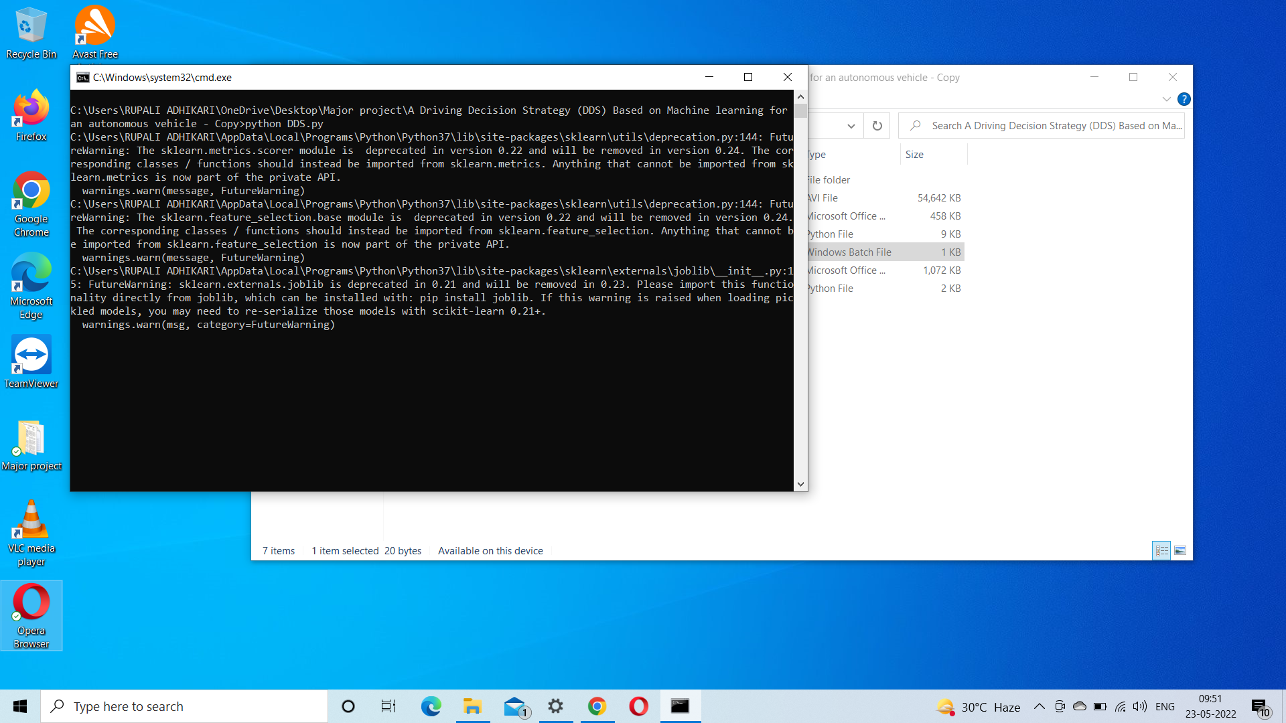
Result

Slide 28
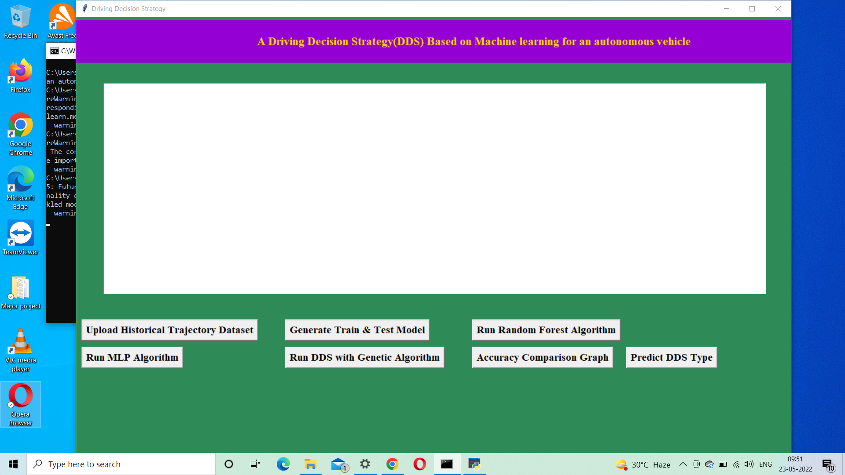

Slide 29
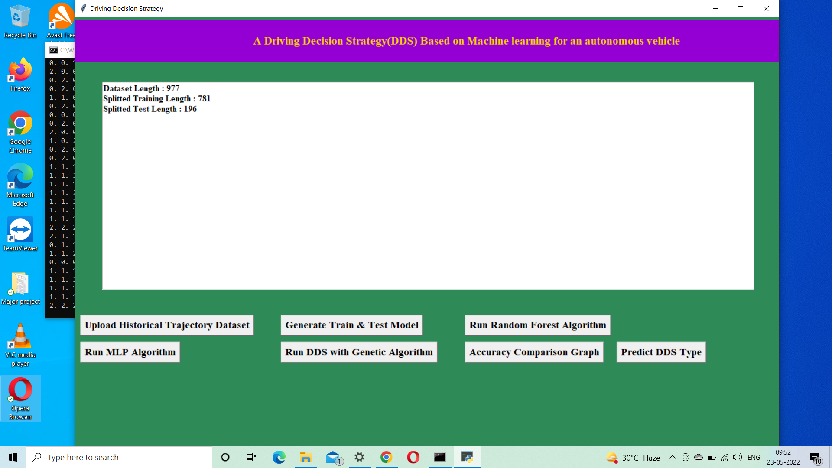

Slide 30
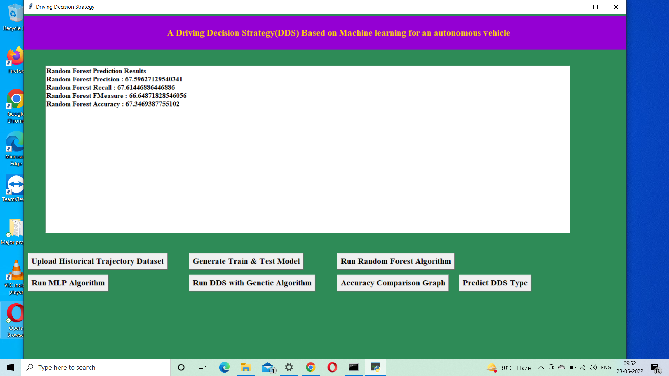

Slide 31
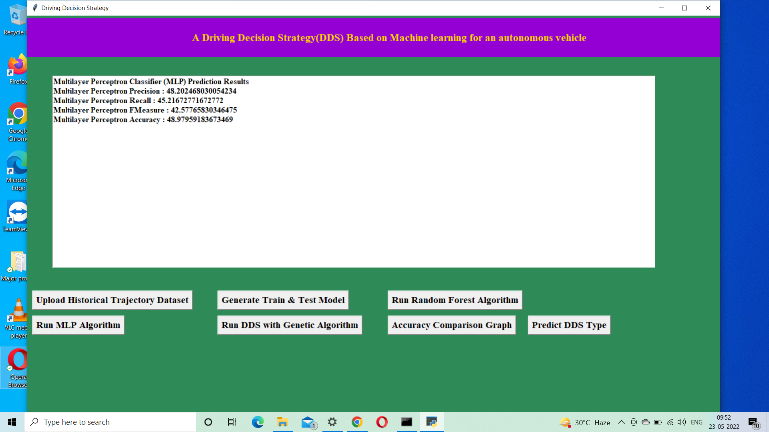

Slide 32
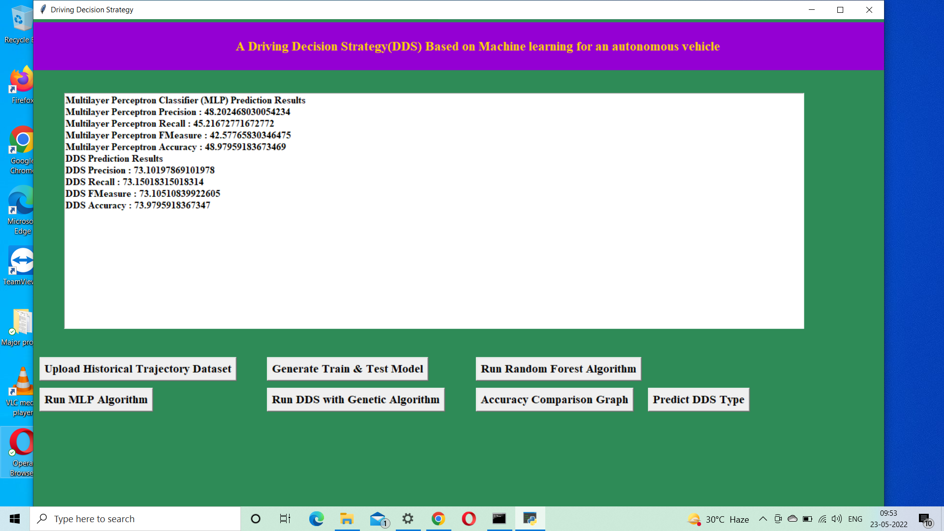

Slide 33
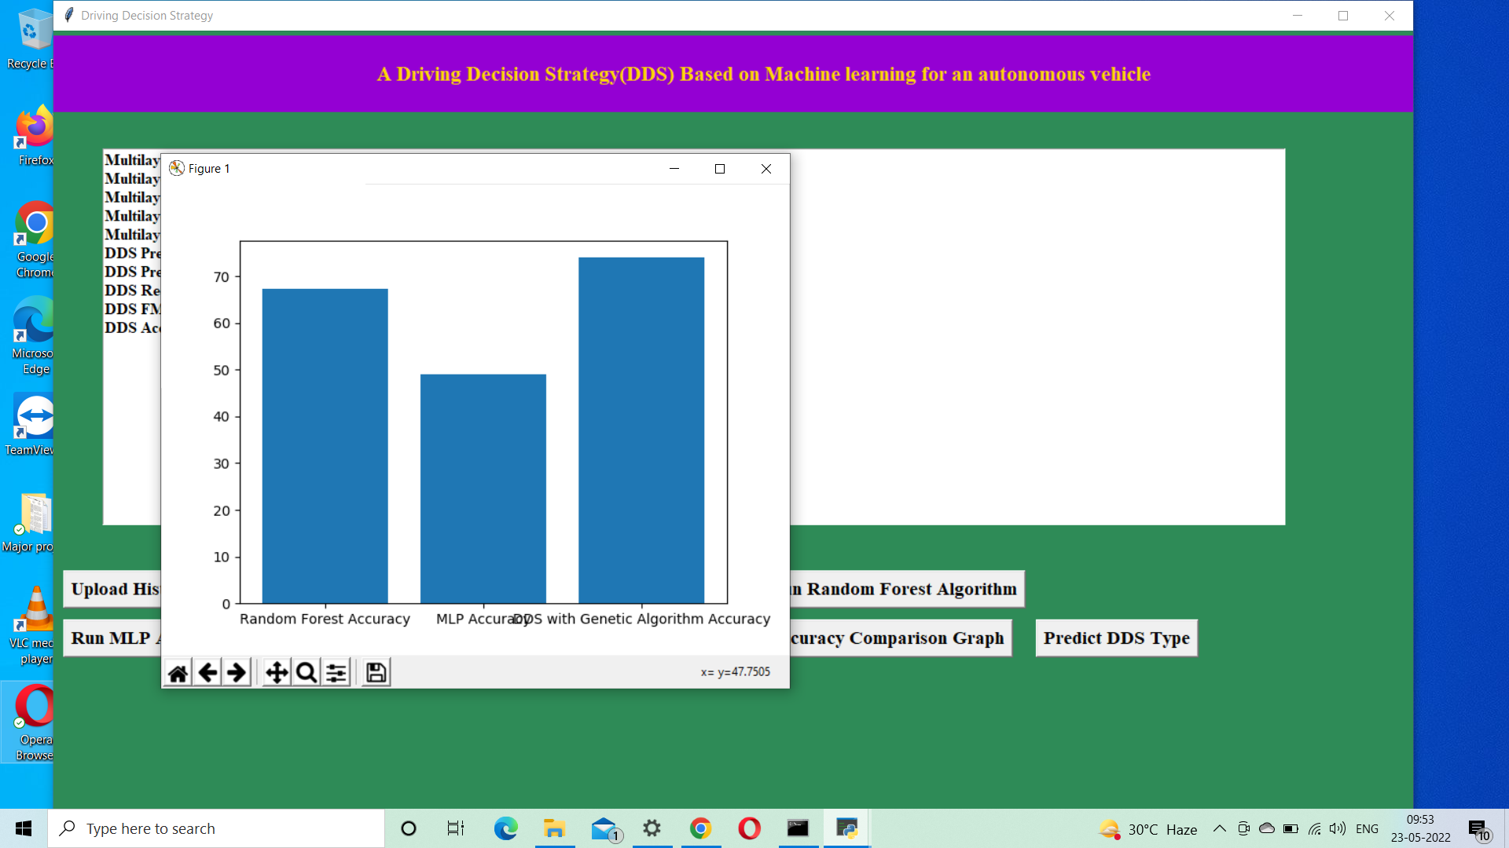

Slide 34
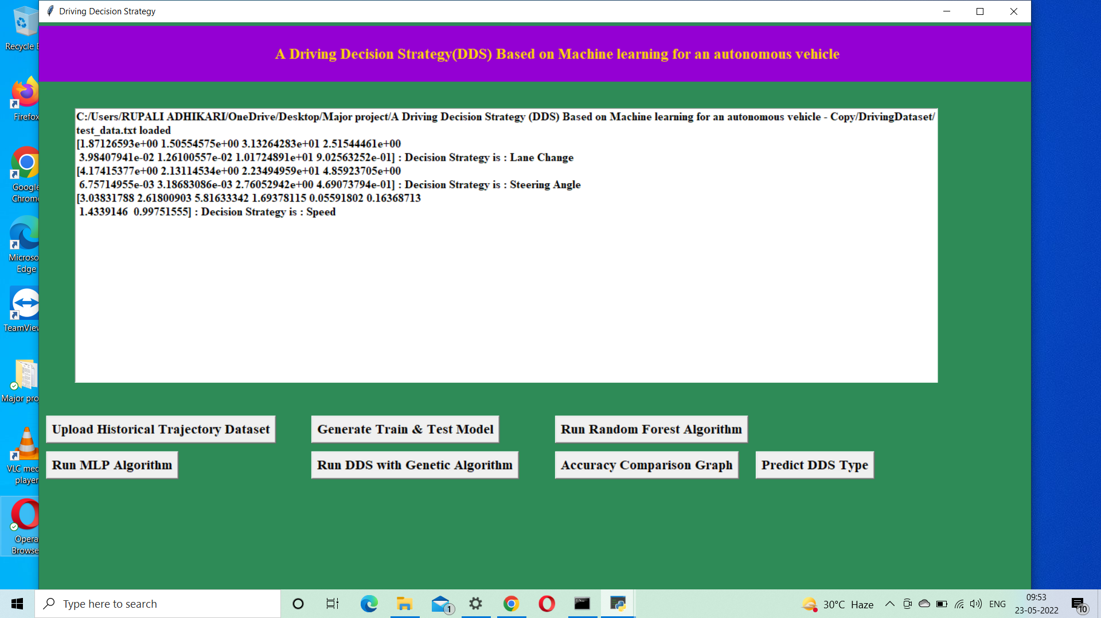

Slide 35
Conclusion
In this project, we have proposed a Driving Decision Strategy. It executes the genetic algorithm based on accumulated data to determine the vehicle's optimal driving strategy according to the slope and curvature of the road in which the vehicle is driving and visualizes the driving and consumables conditions of an autonomous vehicle to provide drivers.
Future Enhancement: Self-driving cars can help drastically reduce car accidents as well as improve the quality of life for everyone.

Slide 36
Reference
Y.N. Jeong, S.R.Son, E.H. Jeong and B.K. Lee, “An Integrated SelfDiagnosis System for an Autonomous Vehicle Based on an IoT Gateway and Deep Learning, ” Applied Sciences, vol. 8, no. 7, july 2018.
Yukiko Kenmochi, Lilian Buzer, Akihiro Sugimoto, Ikuko Shimizu, “Discrete plane segmentation and estimation from a point cloud using local geometric patterns, ” International Journal of Automation and Computing, Vol. 5, No. 3, pp.246-256, 2008.
Ning Ye, Yingya Zhang, Tuchman Wang, Reza Malekian, “Vehicle trajectory prediction based on Hidden Markov Model, ” The KSII Transactions on Internet and Information Systems, Vol. 10, No. 7, 2017.
LiJie Zhao, Tian-You Chai, De-Cheng Yuan, “Selective ensemble extreme learning machine modeling of effluent quality in wastewater treatment plants, ” International Journal of Automation and Computing, Vol.9, No.6, 2012
www.Kaggle.com

Slide 37

Any Queries????

